Slide 1

Robotics in Heathcare
Name: Arafat Rahman
Id:0322310205101052
Session:Spring-25
Batch:22nd
Dept:Computer Science &Engineering

Slide 2
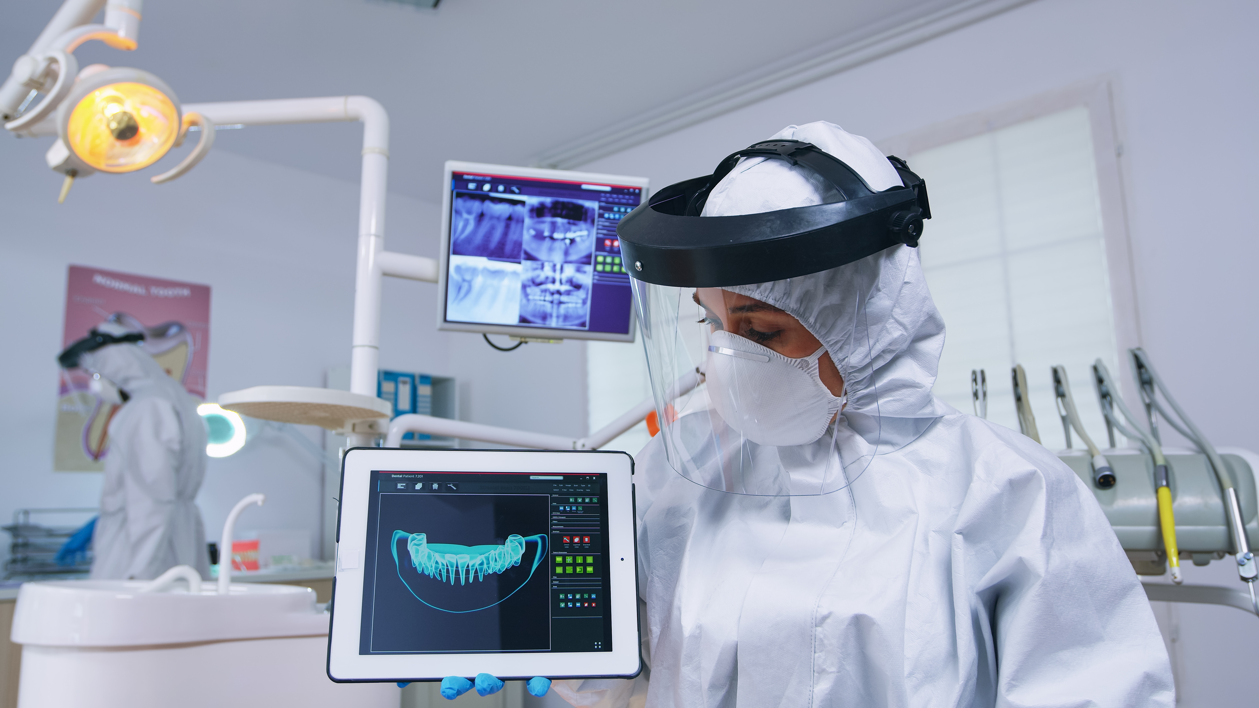
Introduction
Robotics in healthcare refers to the use of advanced robots to assist in medical tasks such as surgery, diagnosis, therapy, and patient care.
1

Slide 3

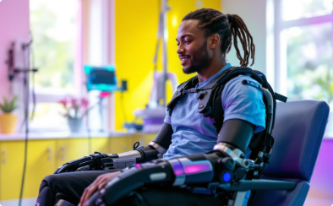


Applications of Robotics in Healthcare
Surgical Assistance
Rehabilitation
Patient Care
Diagnostics
Robots help doctors do surgeries more safely and accurately.
Robots help people recover through physical therapy.
Robots help old or sick people with daily tasks like talking or moving.
Robots and AI help find diseases faster and more correctly.
2

Slide 4



Benefits of Robotics in Healthcare
Enhanced Surgical Capabilities
Improved Patient Care
Healthcare Professional Support
Enhanced outcomes, safety, and care for aging populations.
Increased precision and reduced recovery times.
Reduction in workload for healthcare professionals.
3

Slide 5
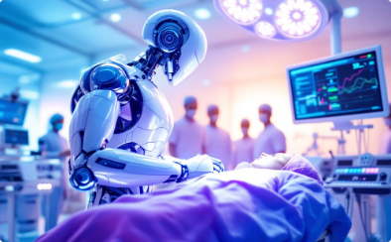



Challenges of Robotics in Healthcare
High Costs
Specialized Training
Ethical Issues
Technical Problems
Robots are very expensive to buy and fix.
Doctors and nurses need special training to use robots.
Concerns about data privacy and patient autonomy.
Robots may break or have software issues.
4

Slide 6

The Future of Robotics in Healthcare
AI will drive personalized medicine.
Nanorobots will deliver drugs directly to cells and help repair them.
Telemedicine robots will become more common in remote areas.
Wearable devices will monitor your health in real-time.
5

Slide 7

# Conclusion
Robots are changing healthcare by making treatment faster, easier, and better.We should use robots carefully and keep improving them to solve problems like cost and privacy.
6

